Slide 1

Universal Parallel Programming Techniques
With examples from C#
Solomon Baarda
23/03/2023

Slide 2

Lecture overview
Introductions
Background
Identifying parallelism
Evaluating performance
Introduction to C#
Parallel techniques
Parallel for
Higher order functions
Threads
Thread pools
Partitioning
This lecture will contain code and live demos!
Prepare yourself!

Slide 3


About me
Hi everyone, I’m Solomon, a 5th year Meng Software Engineering student ☺
10 months experience at Leonardo UK, working on the software for their Osprey radar system
Honours project - created a real time rendering engine for 3D fractals using GPU programming
Created several small projects using procedural generation in Unity
Lots of parallel programming experience!

Slide 4
Learning outcomes
To be able to identify “delightfully parallel” algorithms
01
To be able to suggest different approaches for parallelizing an algorithm
02
To be able to accurately measure runtime, and calculate the speedup and efficiency of a parallel solution
03

Slide 5
Required concepts
Tailored to an audience with a basic understanding of concurrency and parallel programming:
Threads – sequences of execution
Atomic operations – only one thread has read/write access to a variable
Semaphores/barriers – controls thread access to specific regions
Race conditions – multiple threads access/modify a resource at the same time which causes the threads to have inaccurate data

Slide 6
Background

Slide 7
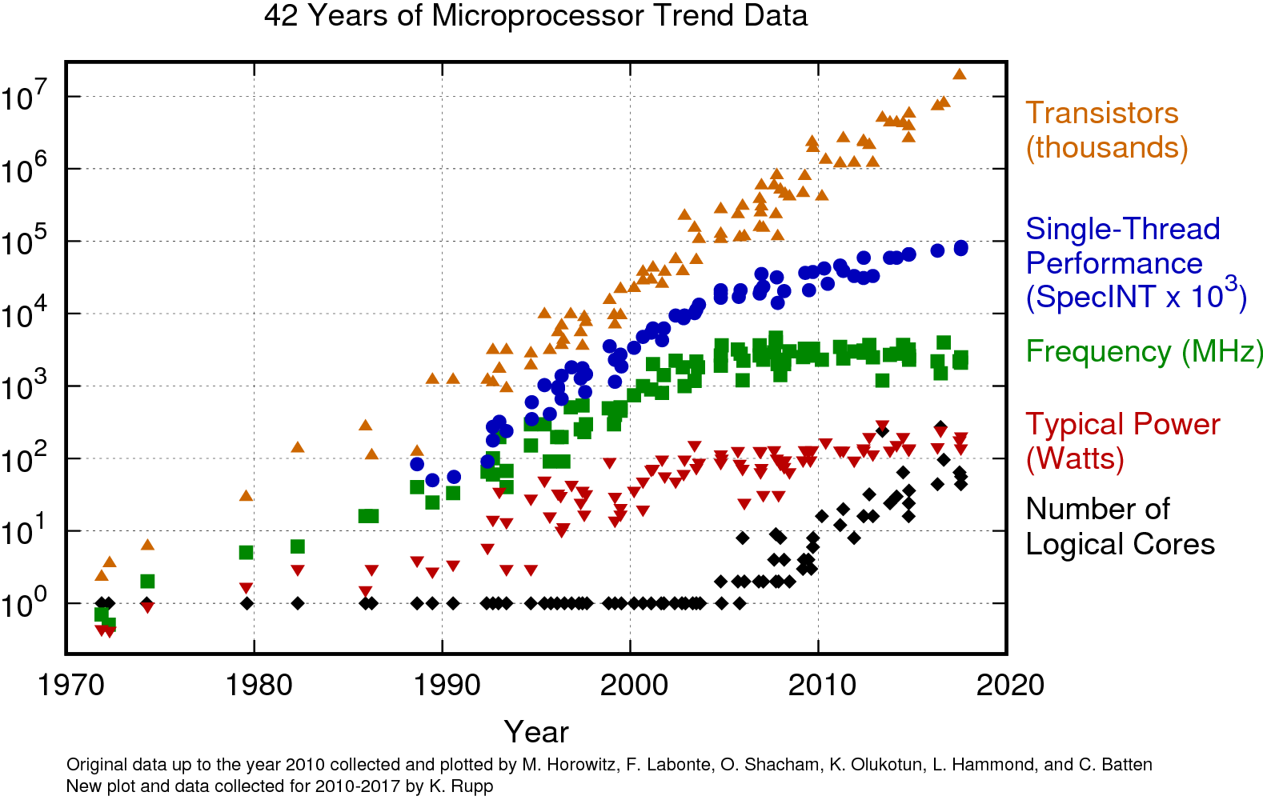
Why do we need parallel programs?
Clock speed is no longer increasing
Its now unlikely that our sequential programs will run much faster on newer processors
To get better performance, we need to change the way that we implement our algorithms
Make use of the parallel nature of our hardware
This requires us to change the way that we express our algorithms

Slide 8
Why do we need parallel programs?
Genome sequence processing – real world computation on a massive scale
Requires processing terabytes of data
Would take months to process on a single machine
Wouldn’t be possible without parallel computing
Uses distributed computing where multiple machines all work together

Slide 9
Identifying parallelism

Slide 10
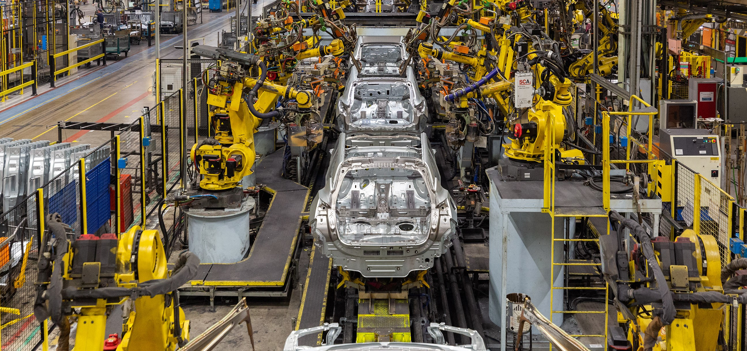
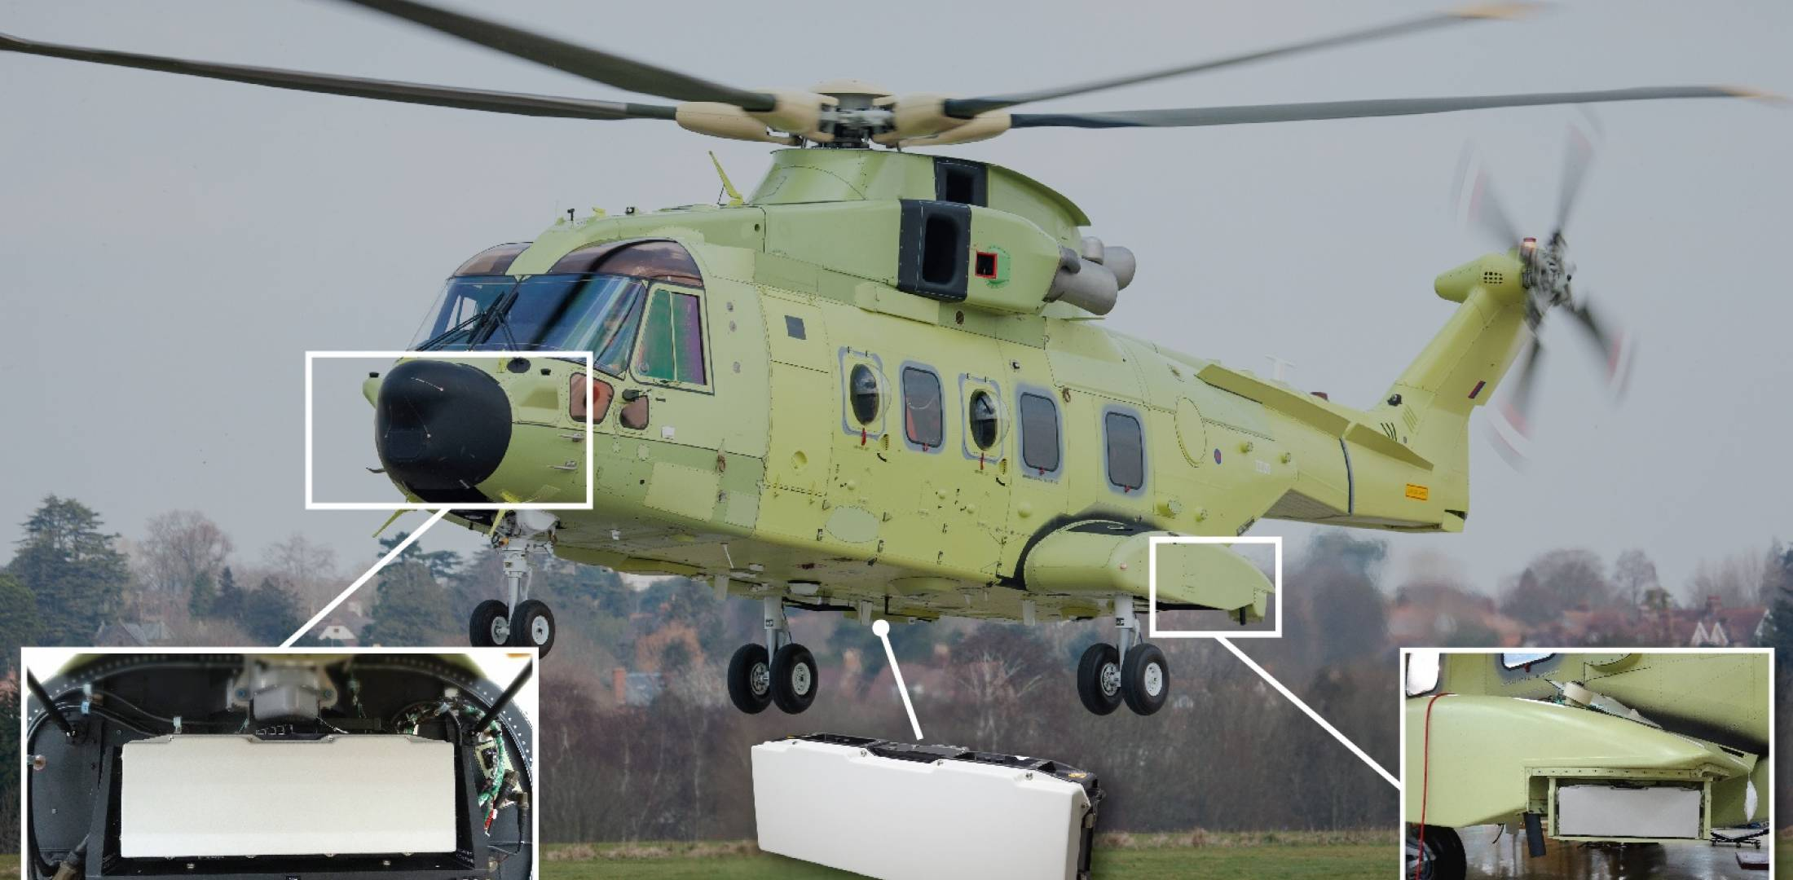
Task parallelism
Each “process” is responsible for executing a different task, on a shared piece of data
Ideal for situations where there is a constant stream of input data
Often processes are dependant on the output of previous process
Examples:
Production line
Radar systems

Slide 11


Data parallelism
Each process executes the same task
Data is partitioned between processes
Each “process” is responsible for its own part of the data
Ideal for situations where each partition can be processed independently
Examples:
Marking exam papers
Image processing

Slide 12
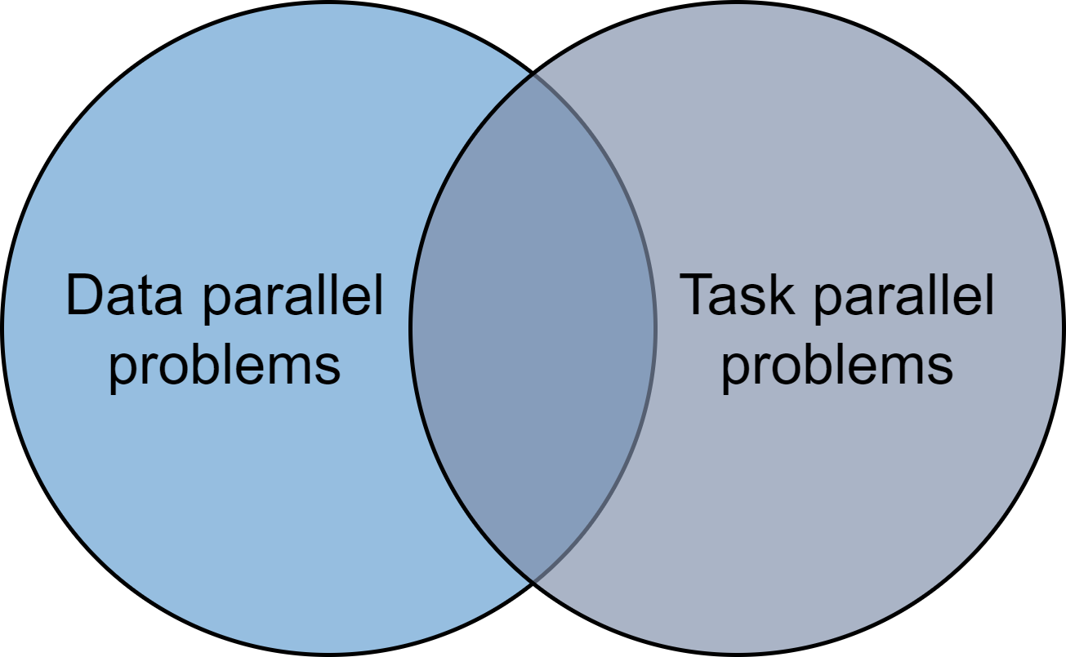
Task/data parallelism overlap
Some problems can be expressed using either data parallelism or task parallelism
Choose the approach that is best suited for your needs
Todays lecture will focus on data parallelism

Slide 13
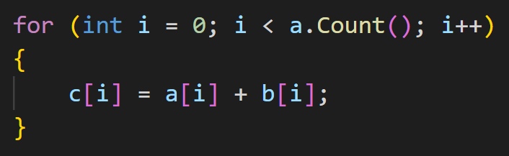
Delightfully/embarrassingly parallel problems
Nothing embarrassing about “embarrassingly parallel” problems
Little or no effort is required for converting the algorithm to run in parallel
This often occurs when there is no need for communication/synchronisation between parallel tasks
Examples:
Vector addition
Mapping a function across a collection
We will focus on some simple examples today
Hopefully the skills that you learn today will allow you to tackle some more advanced problems in the future

Slide 14
Evaluating performance

Slide 15

Why is measuring performance important?
We need to be able to quantify how much our parallel implementation has improved or deteriorated when compared to the original sequential program
This is a core stage in the process of implementing and testing a parallel implementation

Slide 16
Measuring runtime
Measure the total algorithm runtime
Include allocating memory, starting threads etc

Slide 17
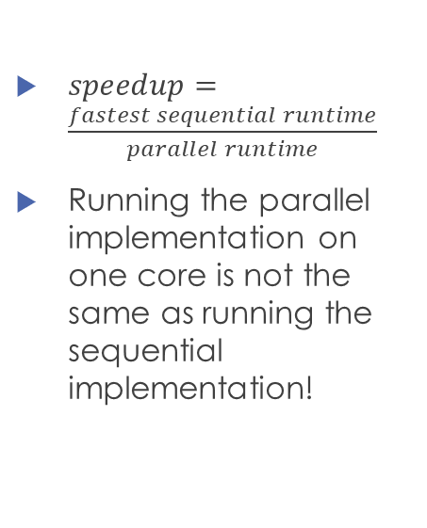
Calculating speedup
$speedup=\frac{fastest sequential runtime}{parallel runtime}$
Running the parallel implementation on one core is not the same as running the sequential implementation!

Slide 18
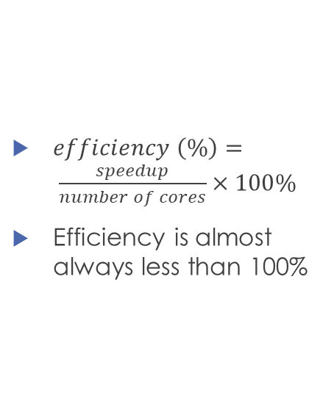
Calculating parallel efficiency
$efficiency \left(\%\right)= \frac{speedup}{number of cores}×100\%$
Efficiency is almost always less than 100%

Slide 19
Any questions?

Slide 20
Introduction to C#

Slide 21

Introduction to C#
High level, strongly typed language, containing all universal Object-Oriented features that we expect
Contains lambda expressions and basic functional programming
Can create reference types and value types
Does a bit of everything - good choice of general purpose programming language
Fills the space left by Java
Used for mobile and desktop applications, server applications, cloud based services, games development

Slide 22
Why C#?
High level syntax
Easy to understand what is going on from a glance
Surprisingly good performance
Despite using garbage collection
Despite compiling to an Intermediate Language which uses Just-In-Time compiling to assembly
Contains many different ways to express parallelism in the default libraries
Draws inspiration from many other different languages
This is not just a lecture about C#!

Slide 23
Parallel techniques

Slide 24
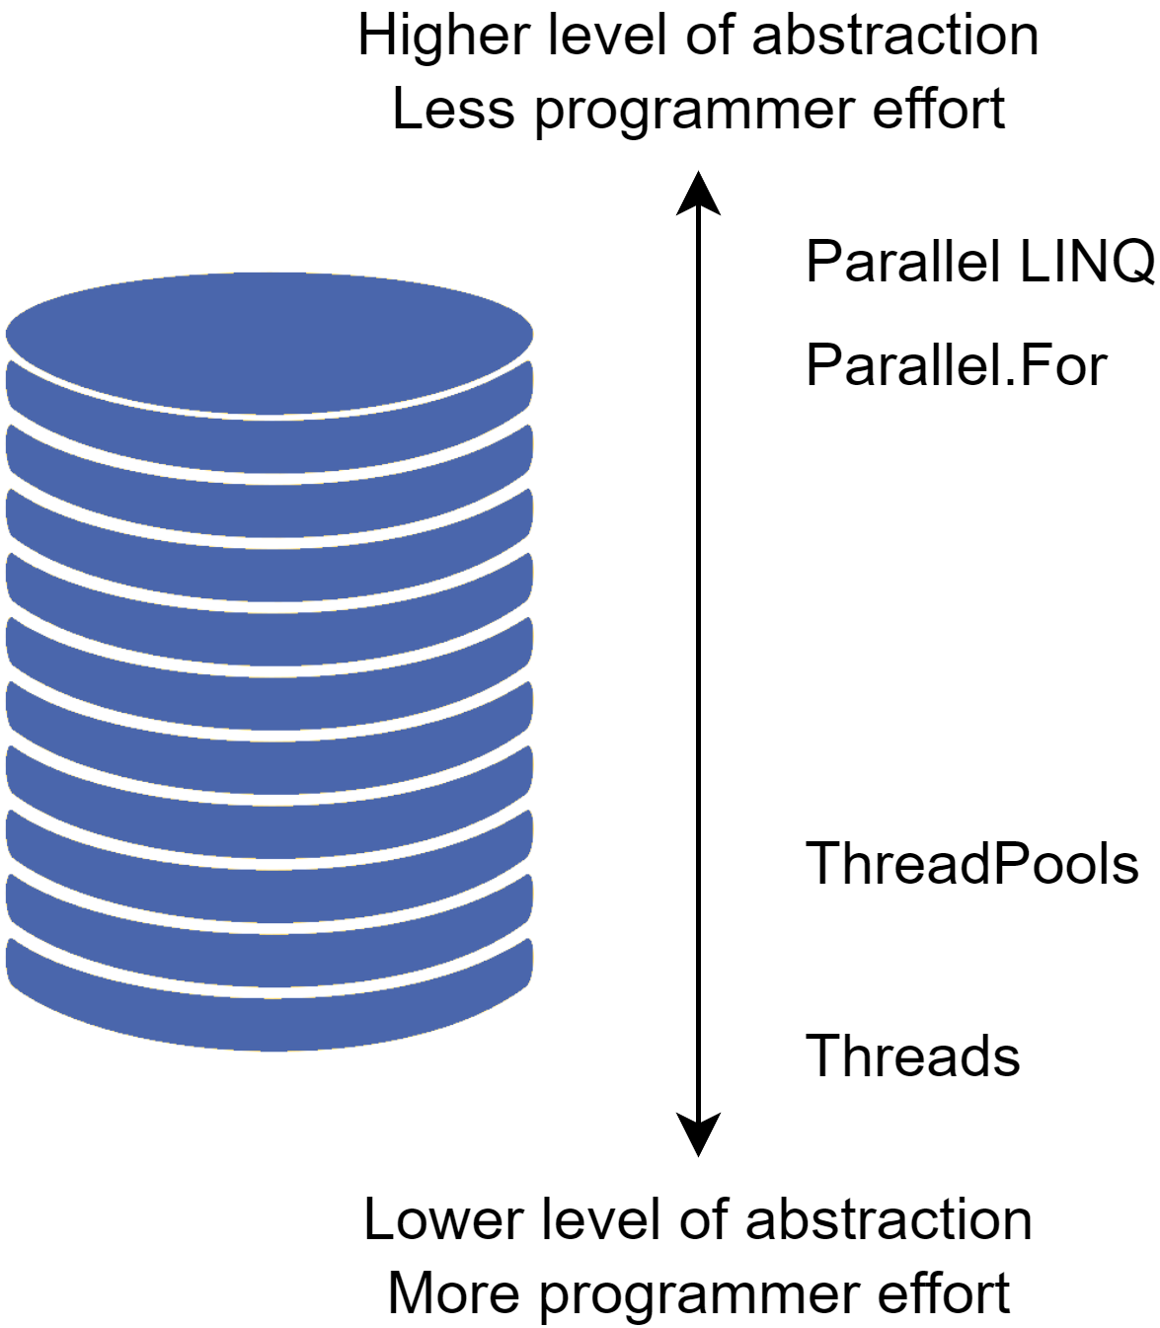
High-level overview
Language constructs:
Parallel for loops
Higher order functions – Parallel LINQ
Threads
ThreadPools
These techniques aren’t exclusive to C#
The content from this lecture can be applied to other languages

Slide 25
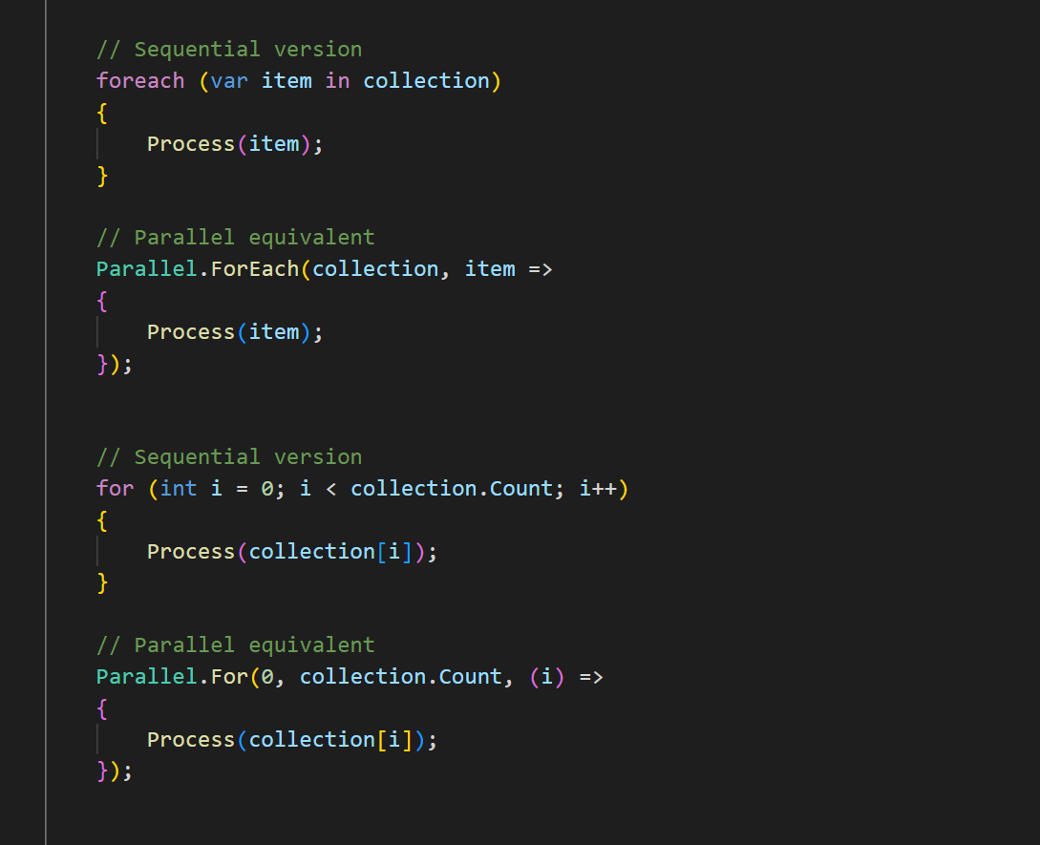
Parallel for
High level parallel pattern which captures the for loop structure
Gives good performance for minimal effort
It is up to the runtime system to distribute the work across processes
Other language equivalents:
C/C++ - OpenMP #pragma omp parallel
C# also supports OpenMP!
Java – parallel streams .parallelStream().forEach()
JavaScript – async Promise.all() and parallel .forEach()

Slide 26
Parallel for demo

Slide 27
Higher order functions
A higher order function is simply a function which takes another function as an argument
Allows us to create reusable and generic patterns which can be reused in many common situations
Map – applies a function across a collection
Filter – filters out elements in a collection that match a condition
Reduce – combines all elements from a collection into a single value e.g. summing an array
Very low programmer effort required

Slide 28
Functional parallel programming
Data is often immutable
Eliminates concurrency bugs like race conditions as data cannot be modified
Often used in combination with higher order functions
Shorter programs
More readable code
Easy to maintain
Requires less developer effort

Slide 29
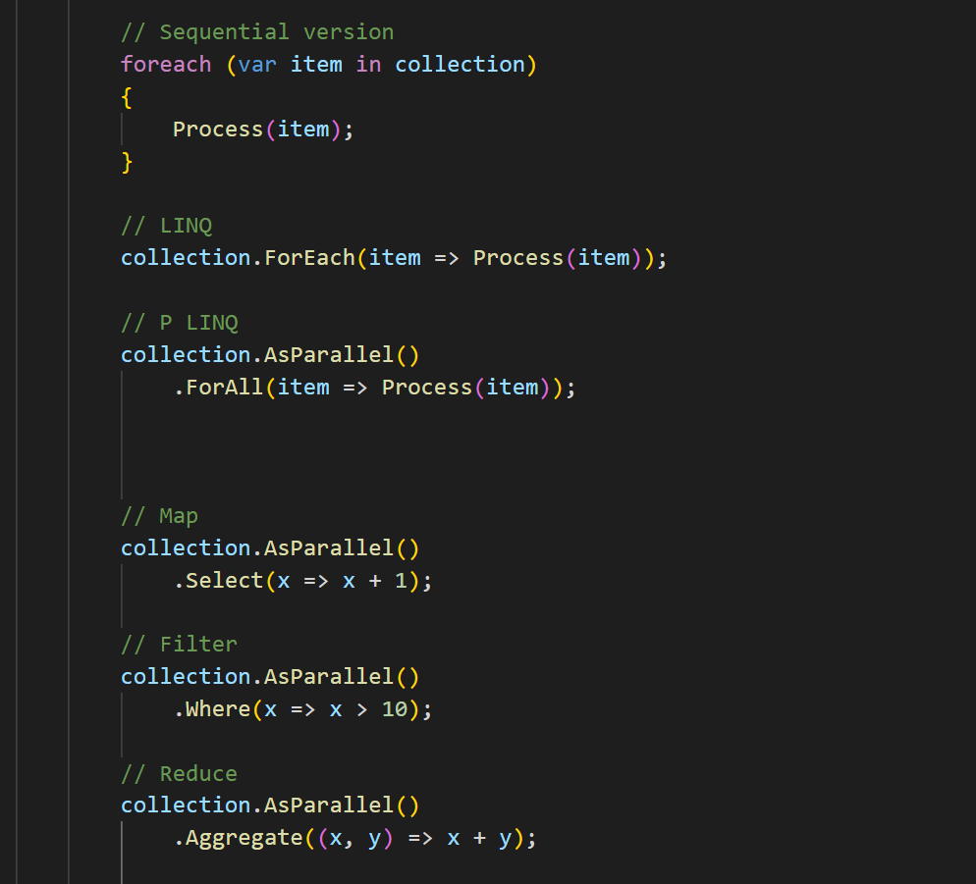
Parallel LINQ
LINQ is the C# Language Integrated Query
Language construct that provides a consistent query language for any strongly typed collection
Allows us to perform a query on any IEnumerable<T>
Includes lists, dictionaries, objects, databases, files e.g. XML
Function naming comes from SQL
Not “true” functional programming – it’s a querying language
However, it does force the developer to express their algorithms functionally
Is there benefit in writing functional style code in a non-functional language?
Shorter programs, readable code, easily maintained, less effort

Slide 30
PLINQ Demo

Slide 31
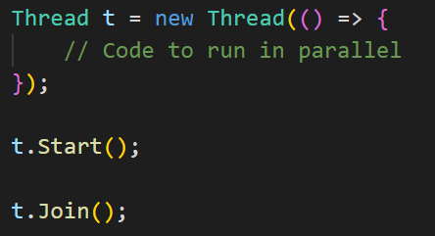
Threads
Very low level language feature
Requires manual synchronisation between threads using locks, atomic variables, critical regions, or thread-safe collections
Can get excellent performance, though it requires more developer effort
C# syntax
Instantiate the thread object
Call the start function to begin computation
Call join to block the current process until the other thread completes
Similar syntax to other languages

Slide 32
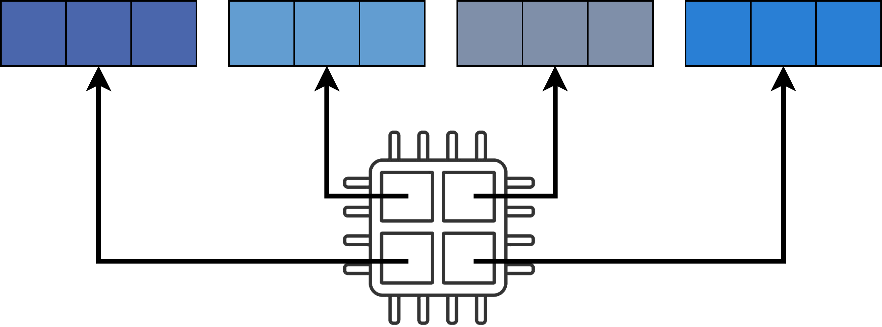
Static partitioning - chunks
Simplest approach to partitioning data
Divide the total amount of work evenly across all processes
Each process performs computation on the same number of work elements
This technique is called static partitioning – as amount of work completed by each thread is always fixed in size

Slide 33
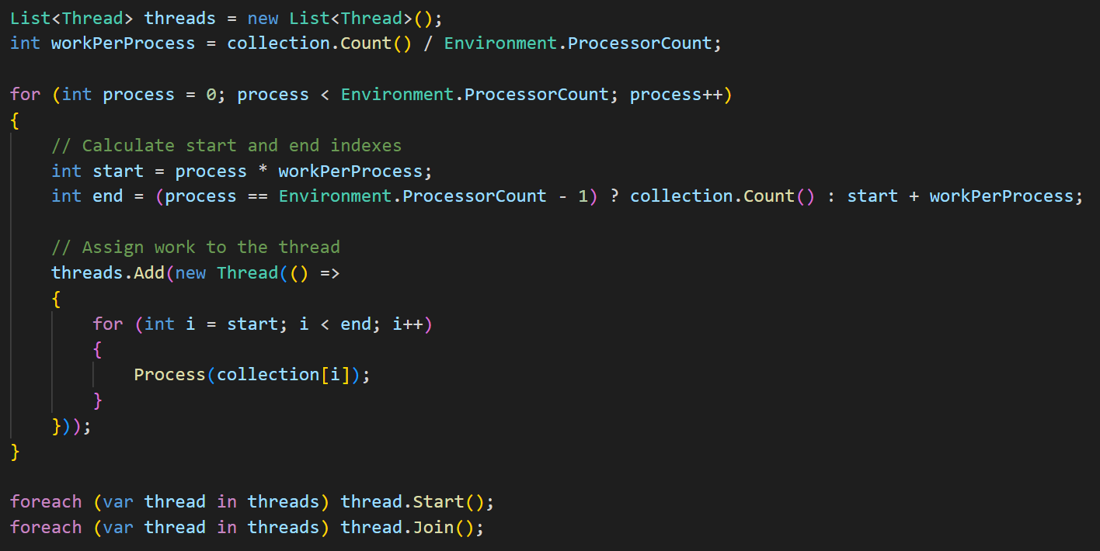
Threads - chunks

Slide 34
Threads Demo

Slide 35
Problems with this approach
Problem 1 - new thread for each stage in the algorithm
Spinning up and tearing down threads is costly
Each thread needs to do enough work to justify the performance hit
If our program has multiple stages, then these thread objects could be reused to give us better performance
Problem 2 - data partitioning
Number of work elements has been distributed evenly, but that doesn’t mean that it takes each thread the same amount of time to process its chunk
If a thread is interrupted, then other threads may finish and be waiting for the other thread to complete

Slide 36
Thread pools
A pool of thread objects managed by the .NET runtime system
Work can be assigned to the pool and the runtime system manages how that work is distributed among threads
The runtime system is responsible for managing the maximum number of threads and for allocating work to a thread
Removes inefficiencies related to excessive thread creation and teardown
Minimises the possibility of oversubscription of system resources
Allows the runtime system to load context information before a thread starts which gives us better performance when context switching
Other language equivalents:
Java - ThreadPoolExecutor
JavaScript – Pool and Worker classes
C/C++ - no standard library implementation, but lots of other libraries

Slide 37
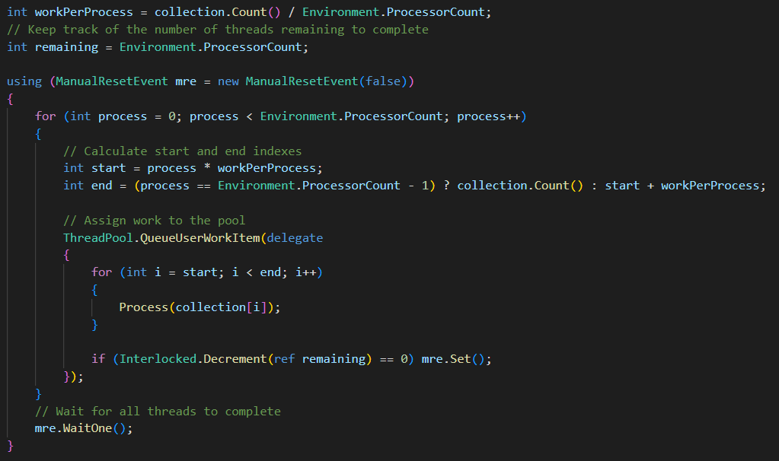
Thread pools

Slide 38
Thread pool demo

Slide 39
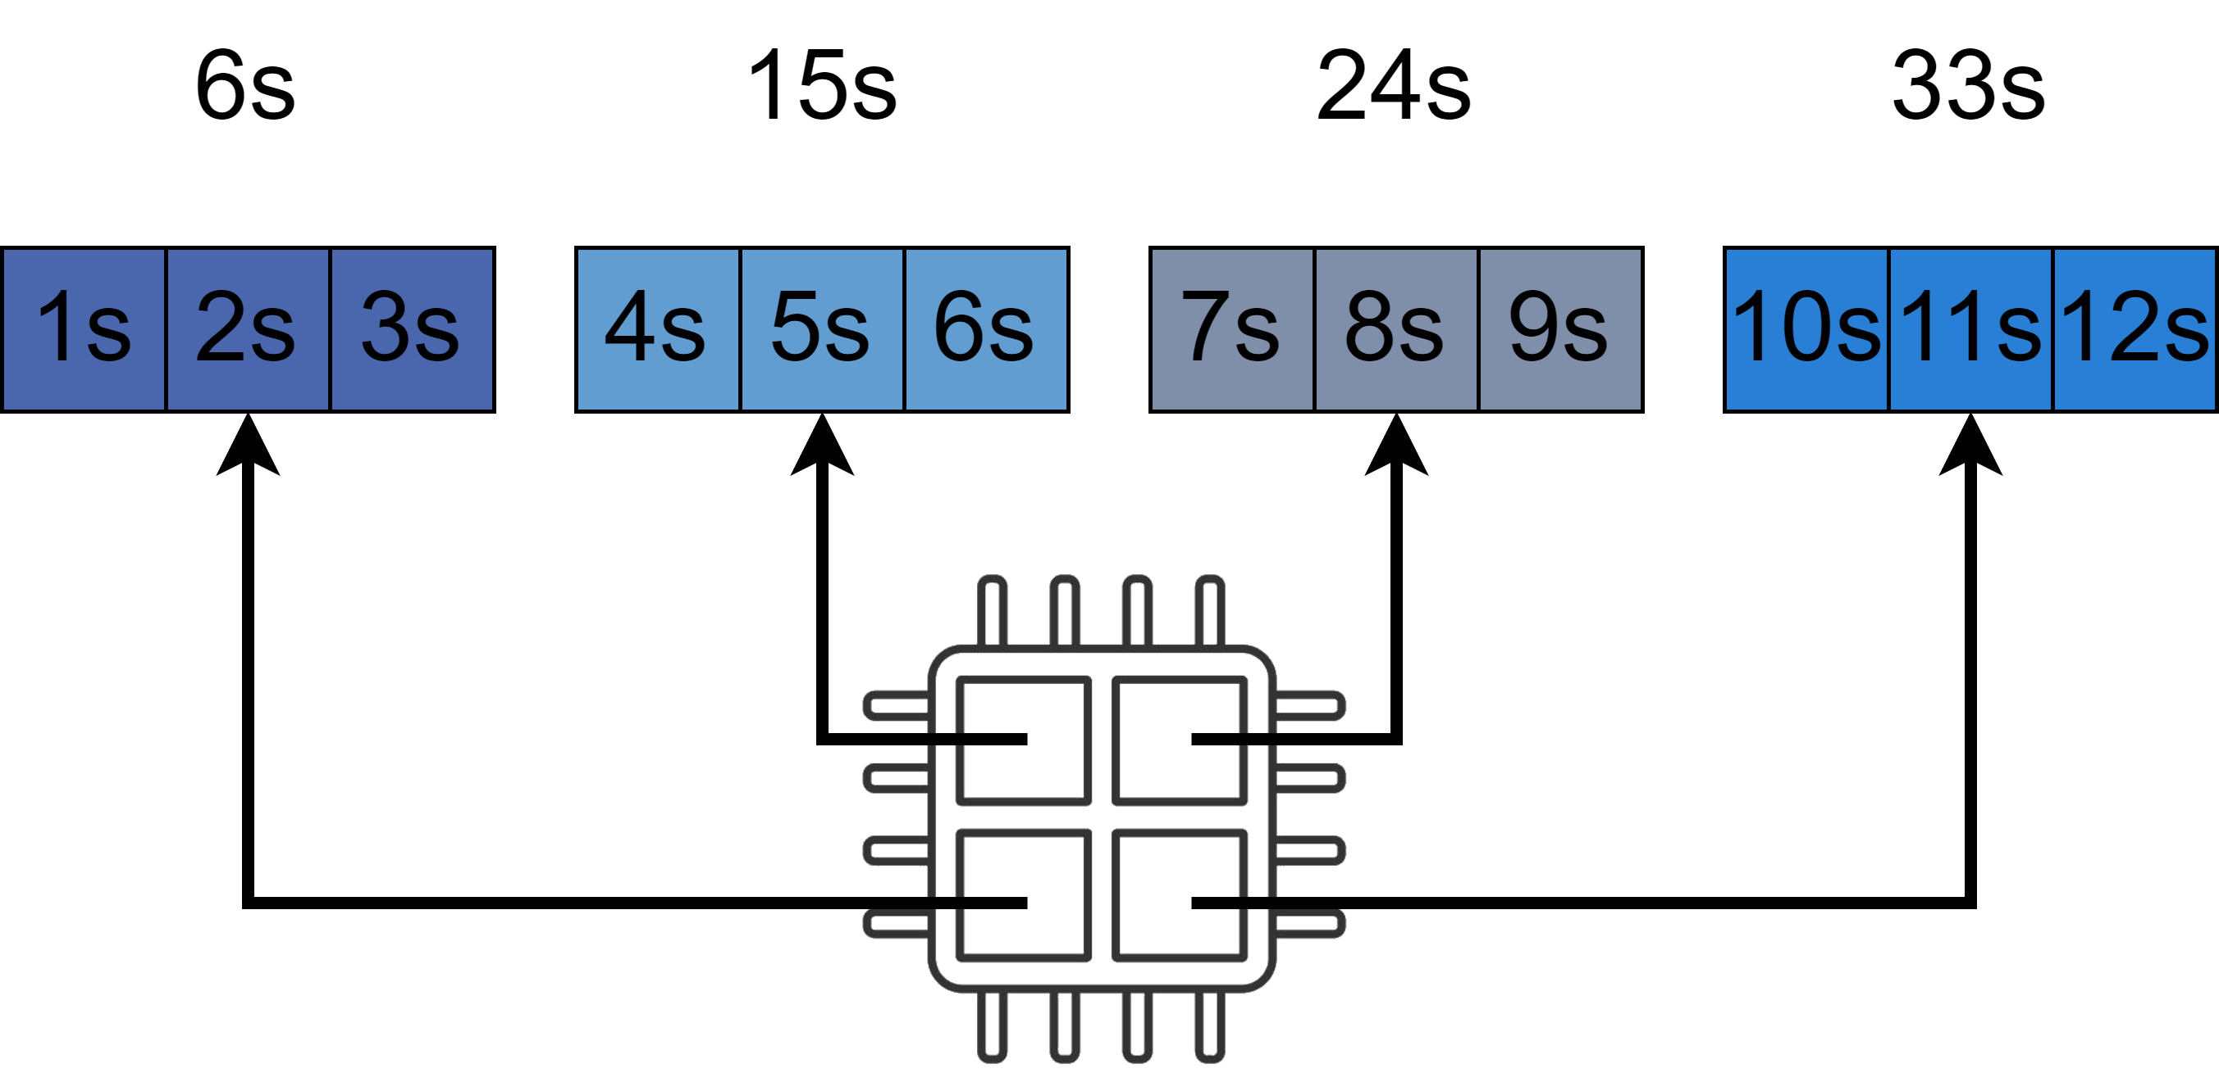
Problems with static partitioning
Static partitioning works well when each chunk takes the same amount of time to process
Either due to the nature of the problem, or other causes like system interrupts
If the workload is not equivalent, then we can get a load imbalance
Take the following worst case example:

Slide 40
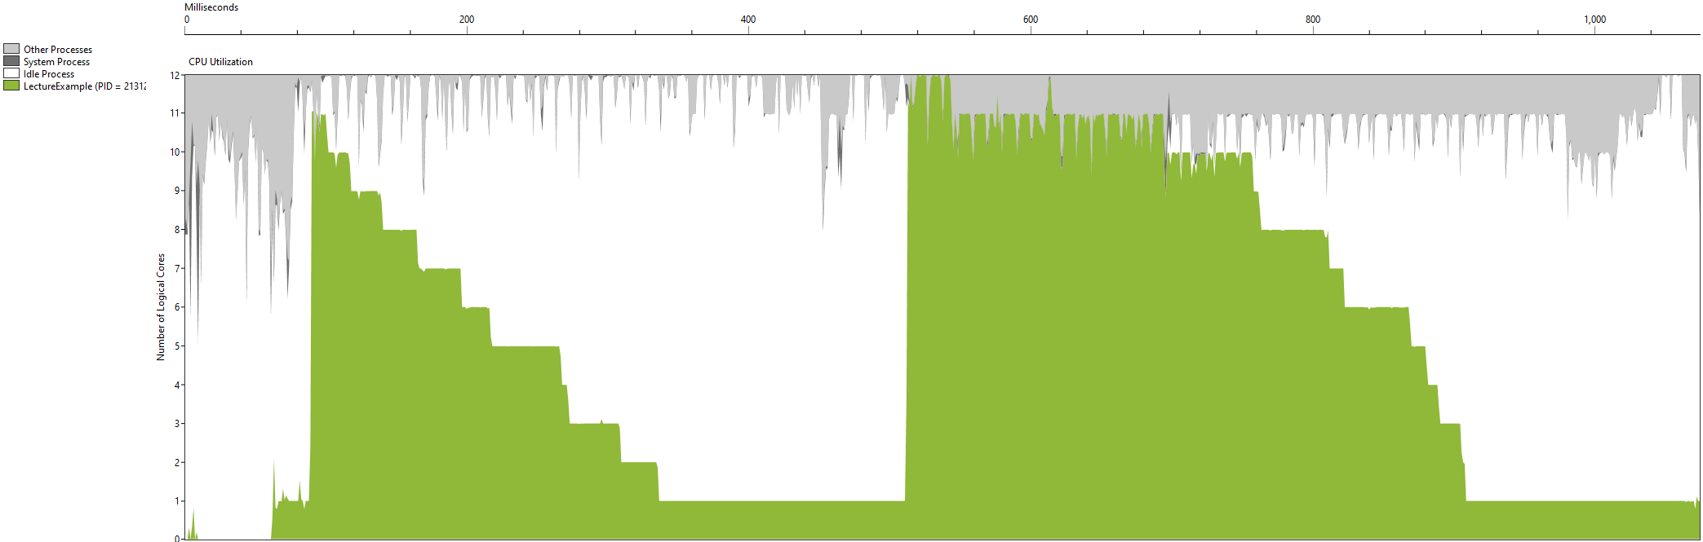
Static chunks profiling results

Slide 41
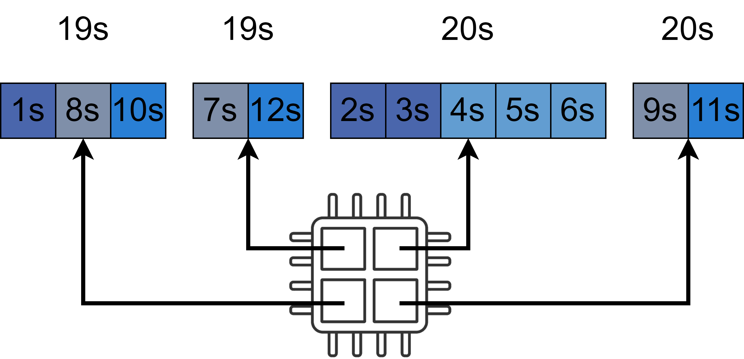
Dynamic partitioning
Dynamically allocate work to threads to achieve a fairer workload
Create a work pool that contains all work to be completed
Threads can compete for work
Similar to a thread pool, but we add the work to a pool instead of the threads
Can be used in combination with a thread pool
Take the following best case example:

Slide 42
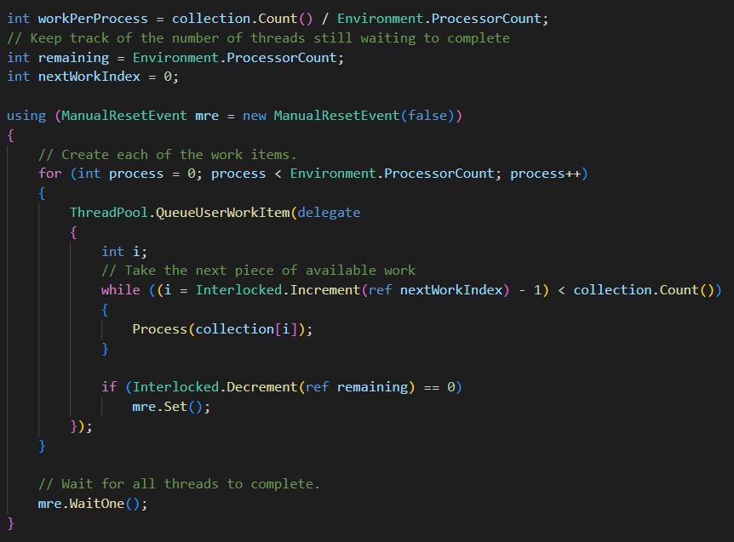
Dynamic partitioning

Slide 43
Dynamic partitioning demo

Slide 44
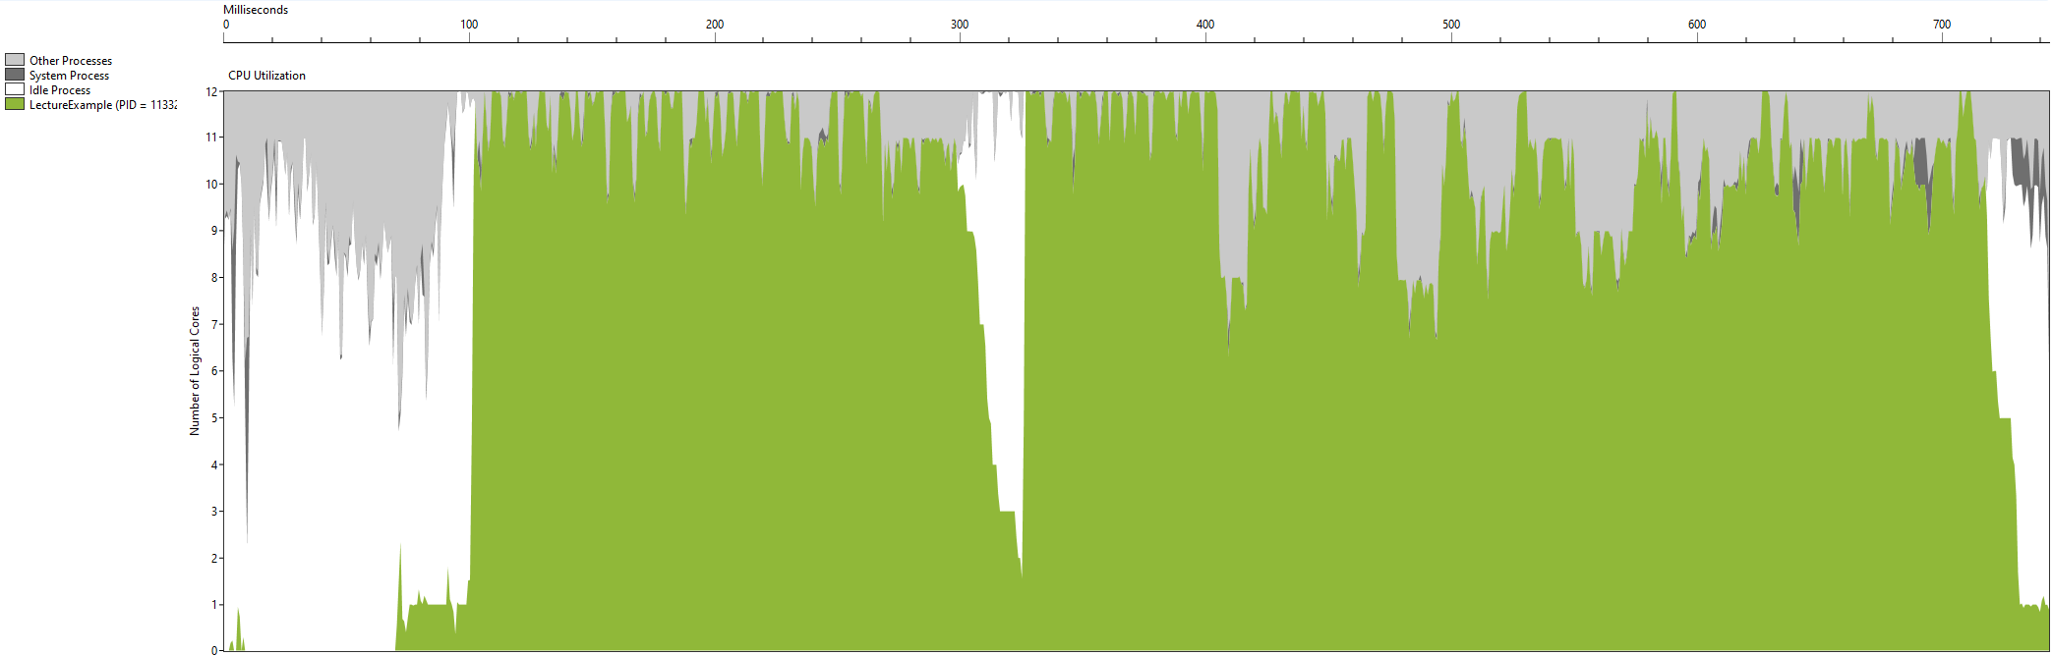
Dynamic partitioning profiling results
Can give much better overall utilisation
However, has a much higher overhead which can also affect performance
We are rarely utilising 100% of our hardware

Slide 45
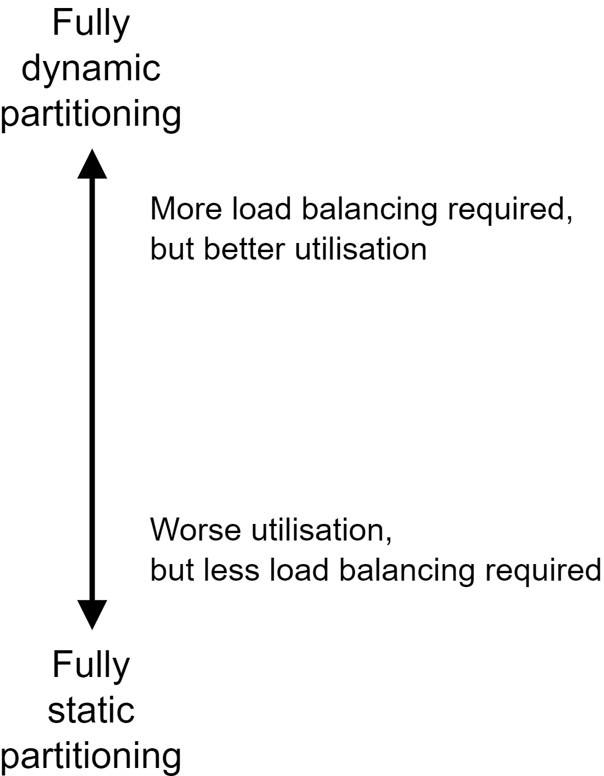
Fine tuning performance
Strike a balance between static and dynamic partitioning
If the chunks are too large, then you can waste performance if other threads are inactive
If the partitions are too dynamic, the scheduling overhead might impact performance negatively
Other things to consider:
Performance will vary between machines – different clock speeds, number of cores, memory speed, memory size
How much performance do you really need?
Choose the approach that is best suited to your problem!

Slide 46
Any questions?

Slide 47
Summary

Slide 48
Summary
Measuring performance
Runtime, speedup, and efficiency
High level techniques:
Parallel LINQ:
Highest level, quick and easy performance gain
Minimal developer effort
Code is written in a functional style which encourages code readability and correctness
Parallel for:
High level, quick and easy performance gain
Minimal developer effort
Captures common for loop pattern

Slide 49
Summary
Low level techniques:
Threads and thread pools:
Low level, requires a lot more developer effort
Can give the best results, if you put the effort in
Static partitioning and dynamic partitioning:
Often a compromise between the two results in the best performance
Choose the best suited language construct for your problem!
How much performance do you really need?

Slide 50

Learning outcomes
To be able to identify “delightfully parallel” algorithms
01
To be able to suggest different approaches for parallelizing an algorithm
02
To be able to accurately measure runtime, and calculate the speedup and efficiency of a parallel solution
03

Slide 51
Future topics
C# Partitioner class – simple interface for partitioning data
Can be used with any parallel approach
C# Task class
Task parallelism, futures, and pipelines
Fork/join parallelism
Advanced LINQ
Parallel database queries
Parallel XML queries
Shared memory vs distributed memory architecture
Designing algorithms for distributed memory architectures

Slide 52
References/further reading
Patterns of Parallel Programming, Stephen Toub, Microsoft, July 1 2010, https://www.microsoft.com/en-us/download/details.aspx?id=19222
Parallel Programming in C#, Hans-Wolfgang Loidl, 2021, https://www.macs.hw.ac.uk/~hwloidl/Courses/F21SC/csharp-par.pdf
F21DP Distributed and Parallel Technologies, Rob Stewart

Slide 53


Up next
Lets take a break
Afterwards we will move onto our lab session
Use the techniques discussed in this lecture to parallelise the Sobel Edge Detection algorithm
Lab sheet and installation instructions can be found on GitHub: https://github.com/SolomonBaarda/f21sm-lab
Thank you for attending! ☺

Slide 54
Lab session

Slide 55
Lab session
Sobel edge detector
An image processing algorithm used for identifying the edges of objects within an image
Everything is hosted on GitHub: https://github.com/SolomonBaarda/f21sm-lab
Installation instructions – README.md
Lab sheet – LABSHEET.md
Make a note of your answers in a word document
We will spend some time at the end of the session to discuss your answers

